Slide 1
Formulating and Testing Hypotheses
Benjamin Hansen
Updated March 24, 2024

Slide 2
Formulation
Many system developers consider “I hypothesize that this strategy idea will make money” to be adequate.
“See the backtest looks better.”
Understand your business constraints and objectives
Create a hypothesis for the system
Modularity
build the system in pieces
test the system in pieces
measure how likely it is that you have overfit

Slide 3
Hypothesis Testing
“Essentially, all models are wrong, but some are useful”. - George Box (2015)
To create a testable idea (a hypothesis), we need to:
formulate a declarative conjecture
make sure the conjecture is predictive
define the expected outcome
describe means of verifying (testing) the outcome

Slide 4
Good Hypothesis
A good/complete hypothesis statement includes:
what is being analyzed (the subject),
the dependent variable(s) (the output/result/prediction)
the independent variables (inputs into the model)
the anticipated possible outcomes, including direction or comparison
addresses how you will validate or refute each hypothesis

Slide 5
Looking for Hypotheses
Many research papers contain multiple hypotheses.
Phrases to look for:
demonstrates
shows that
establish
improve upon
Question: Do the hypotheses depend on each other?

Slide 6
Basics of testing hypotheses
how you will refute a hypothesis is generally statistical
if your results are not statistically significant you can reject most hypotheses
the so-called null hypothesis is usually that something is not true
so the null is generally that there is no relation, or the claim is not true
rejecting the null says that you have statistical probability that the observation is not likely to be due to chance
a P-test is a probability test which reports the probability that the claimed result is random
a T-test is generally used to test whether the means of two populations are significantly different

Slide 7
Specifying Tests
facts to support or refute
general tests
MSFE
confusion matrix
standard errors
Monte Carlo errors
specific tests
tests related to the model
tests of the prediction
tests of the relationships between variables

Slide 8
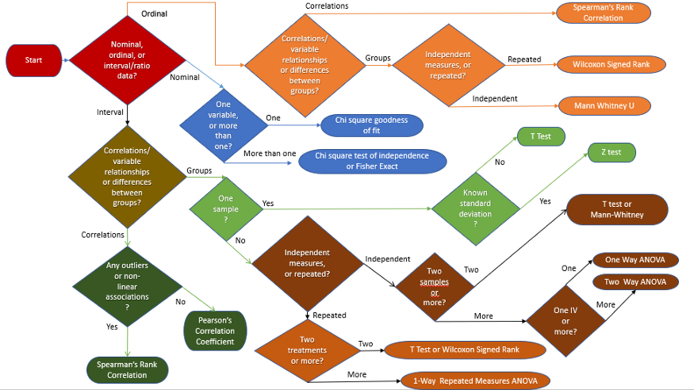
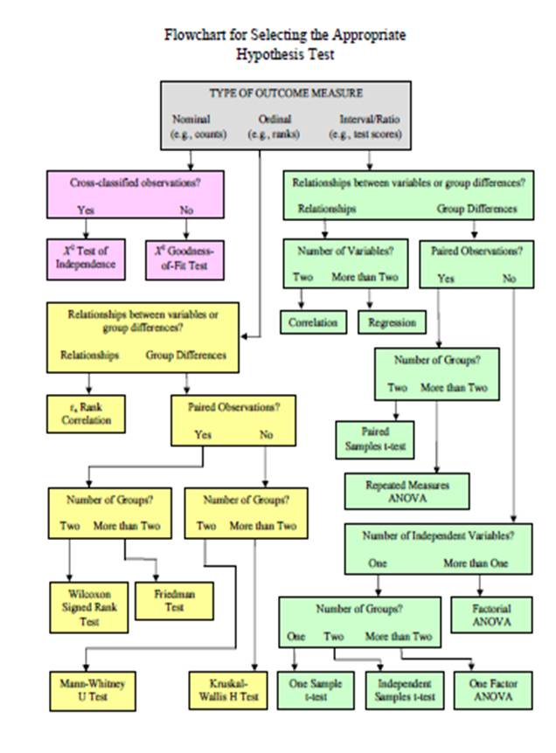
Choosing Statistical Tests
From a deleted blog post
https://roghiemstra.com/statprimer.html

Slide 10
Correlation
we are often interested in the correlation of assets
or in the correlation of indicators
or in the correlation of residuals
your hypothesis is
that the correlation should be significant in cases where you think things are related
that the correlation should not be significant where e.g. you are looking at residuals of a model

Slide 11
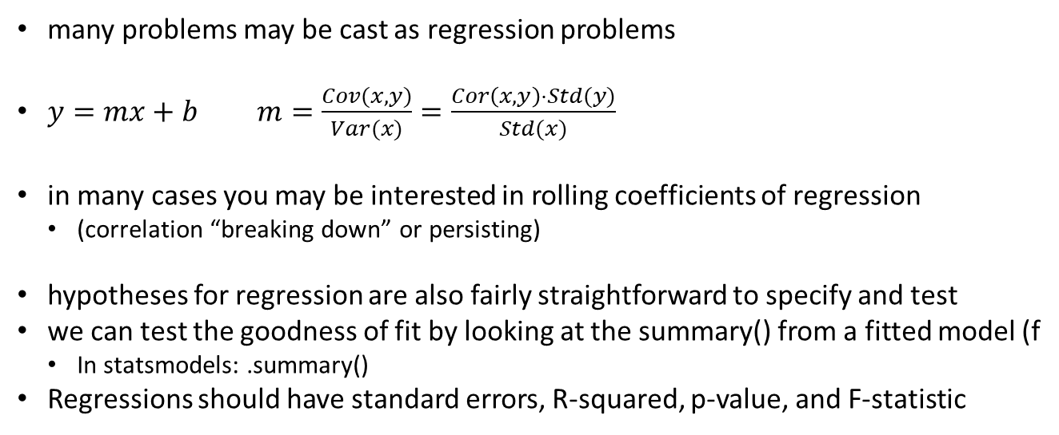
Linear model Hypotheses
many problems may be cast as regression problems
$y=mx+b$ $m=\frac{Cov(x,y)}{Var(x)}=\frac{Cor\left(x,y\right)⋅Std(y)}{Std(x)}$
in many cases you may be interested in rolling coefficients of regression
(correlation “breaking down” or persisting)
hypotheses for regression are also fairly straightforward to specify and test
we can test the goodness of fit by looking at the summary() from a fitted model (f
In statsmodels: .summary()
Regressions should have standard errors, R-squared, p-value, and F-statistic

Slide 12
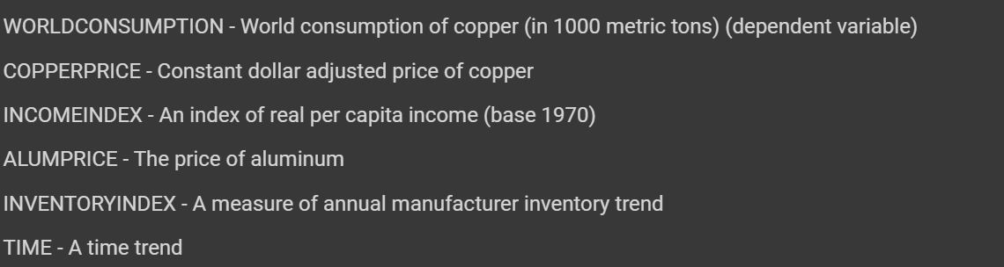
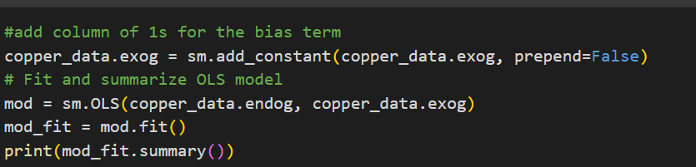
Regression Example
Link to Copper Regression and Confusion Matrix Collab Notebook

Slide 13
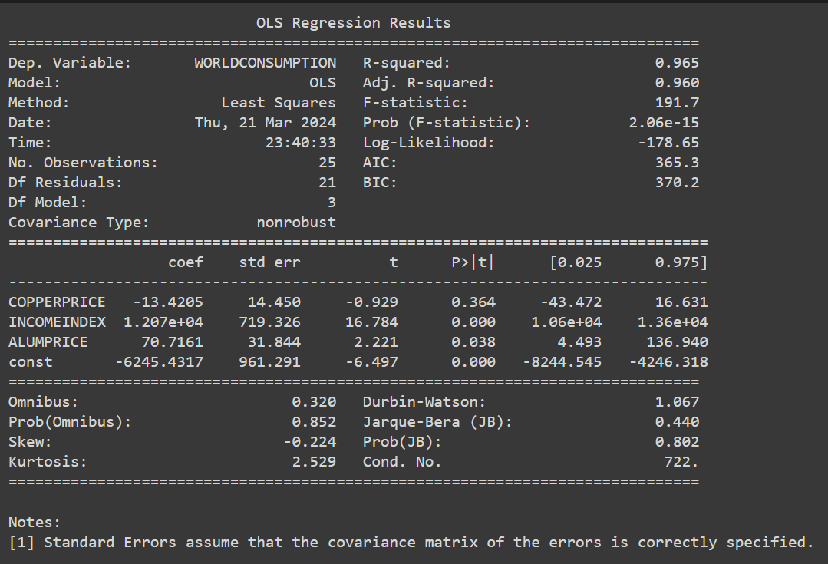
Regression Output
(Removed TIME and INVENTORYINDEX)

Slide 14
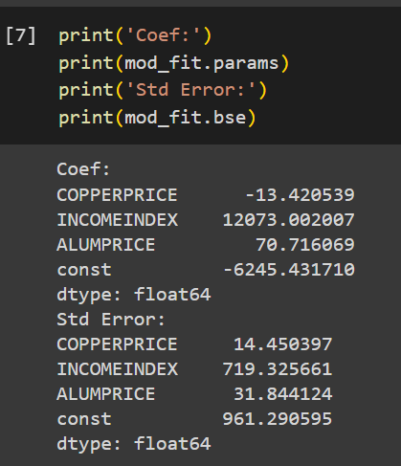
Parameter Extraction

Slide 15
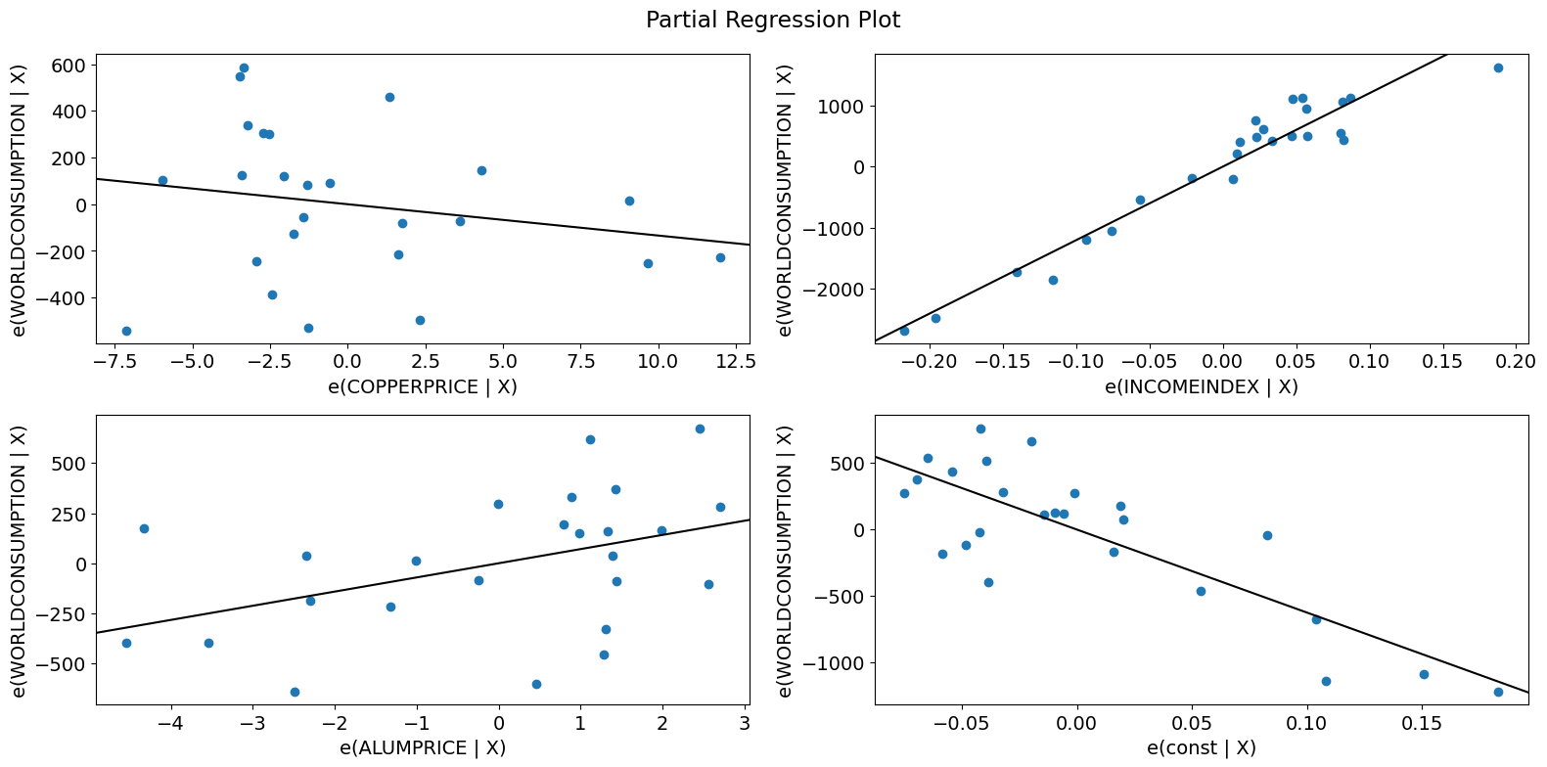
Diagnostics and visualization

Slide 16
Forecast Errors
Forecast Error is the difference between the ‘true’ value and the predicted value
many different estimates are possible, and some will help you evaluate your model
the ‘naive’ forecast simply uses the prior observation as the forecast
a ‘drift’ forecast adds a trend to the prior observation
common measures of forecast error
MSFE/RMSE Mean squared forecast error or root mean squared error
MAE: Mean Absolute Error
MAPE: Mean Absolute Percentage Error
MASE: Mean Absolute Scaled Error
See https://otexts.com/fpp2/accuracy.html for a great discussion of standard forecast error metrics (in R)
Docs in python: https://www.statsmodels.org/dev/tools.html#measure-for-fit-performance-eval-measures https://scikit-learn.org/stable/modules/model_evaluation.html#regression-metrics

Slide 17
What do those forecast errors have to do with hypothesis testing?
you can hypothesize that the forecast is statistically significant
if the forecast is not significantly different from random or naive forecast, you can reject the hypothesis

Slide 18
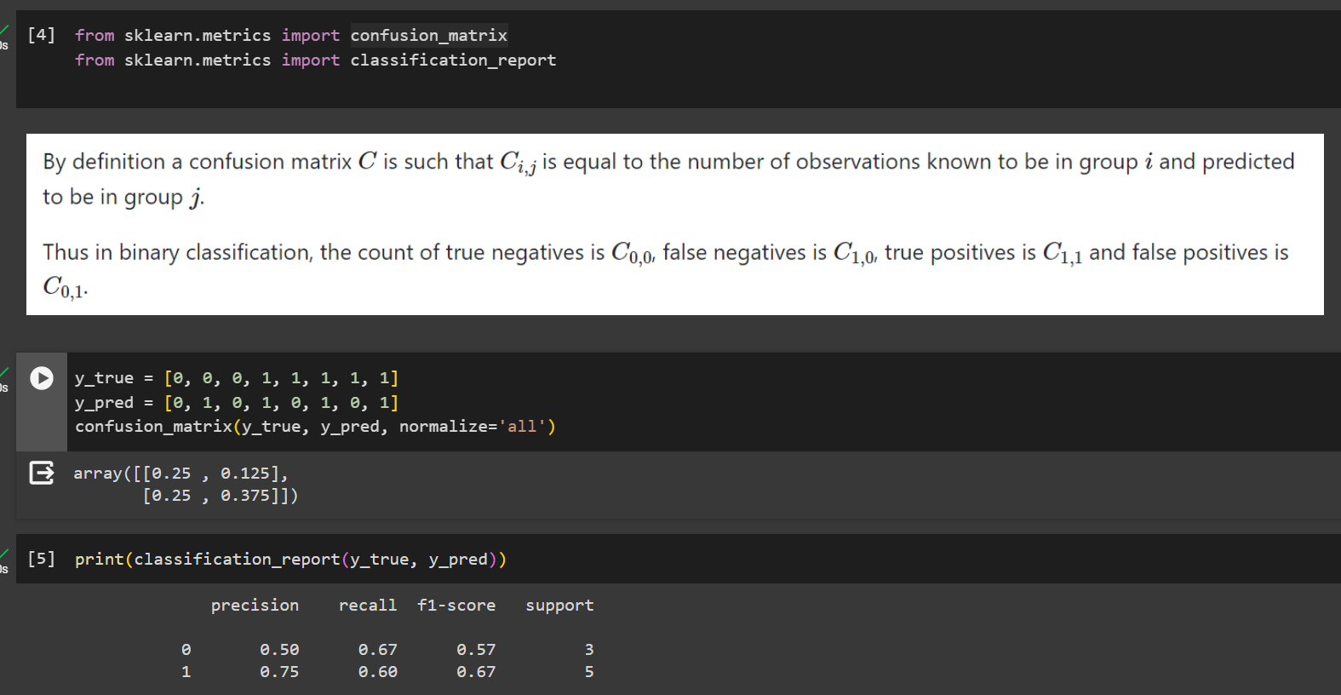
Classification
https://scikit-learn.org/stable/modules/model_evaluation.html#classification-metrics

Slide 19
Hypotheses and Risk of Ruin
Don’t do this:
“I hypothesize that this strategy idea will make money.”
Specifying hypotheses at the beginning reduces the urge to
modify them later
adjust expectations while testing
revise the objectives
Construct ad hoc hypotheses
Seek to answer what and why before going too far.
Strong hypotheses guard against risk of ruin

Slide 20
Thoughts/Resources
this lecture is not a replacement for sound statistical knowledge
many statisticians spend their entire careers teasing out subtle relationships
data scientists could stand to have a better understanding here too
quants who ignore hypothesis testing are unlikely to stay in the field for long
Resources
Peixeiro (2022) Time Series Forecasting in Python.
Ruppert and Matteson (2015) Statistics and Data Analysis for Financial Engineering, 2nd ed.
Hyndman and Athanasopoulos (2018) Forecasting, Principles and Practice
Kissell (2007) Statistical Methods to Compare Algorithmic Performance
https://en.wikipedia.org/wiki/All_models_are_wrong

